Slide 1
National Pharmacare in Canada:
Choosing a Path Forward
Kevin Page
President & CEO
Institute of Fiscal Studies and Democracy at the University of Ottawa
© Copyright 2018 IFSD Institute of Fiscal Studies and Democracy. All Rights Reserved.

Slide 2
Key Messages
Decide desired outcomes and performance criteria before structuring pharmacare
National pharmacare should:
  Be universal
  At minimum, use a limited formulary to cover essential medicines, and then design expansion
  Avoid deductibles and copayments
  Be funded largely by the federal government

Slide 3
Path to National Pharmacare
1964 Hall Commission
1997 National Forum on Health
2002 Romanow Report
Why were public drug coverage recommendations never accepted?
  Lack of political will? Consensus? Policy complexity? Cost?
After 54 years, will national pharmacare become reality?

Slide 4
Why National Pharmacare?
Canadians, per capita, paid an average of over 40% more on prescription drugs than the OECD average

Slide 5
Potential Savings are Substantial
Notes:
Chart for coverage array , graphic way to explain the variation across

Slide 6
Array of Public Drug Coverage
Copayment range: $0-$30
Deductible range: 3-20% of income
Most provinces cover seniors and people with low income
Some provinces cover children, people with cancer, cystic fibrosis, people in palliative or long-term care
… opportunities to improve coverage

Slide 7
Fiscal Sustainability
Cost-shifting from private to public
Who will pay for this?
  Federal government
  Provincial & territorial help?
  Role of private insurance?

Slide 8
Fiscal Sustainability

Slide 9
Fiscal Sustainability

Slide 10
Fiscal Sustainability of Pharmacare
Notes:
If the federal government was to take on the entirety of the PBO cost estimate, their position of fiscal sustainability would deteriorate. However, the federal government is currently fiscally sustainable which makes it better suited to taking on costs than provinces.

Slide 11
Fiscal Sustainability of the Country

Slide 12
Ways to Mitigate Unsustainability
Raise revenues or reduce spending in other areas
  For example, increase GST from 5% to 7%
Cost-sharing mechanisms
  Copayments or deductibles
  Provincial sharing
Begin with limited formulary and design expansion

Slide 13
International Lessons
Other countries spend much less on drugs but consume equal or greater amount
Centralized formularies lead to lower costs
Other countries used less private funding
Other countries with lower drug prices were in a much better position to attract pharmaceutical investment than Canada
Copayments and deductibles are financial barriers

Slide 14
High Drug Costs Reduce Adherence
Copayments of $7 to $17 in Germany, and $2 to $8 in New Zealand
Australia has copayments of $35
Patients face very low costs in UK and Netherlands
Notes:
Chart 10 shows Canada has a high rate of people not filling prescriptions due to the cost compared to countries with public drug coverage. Australia is higher due to high co-payments which present a barrier to access. BC has a relatively high co-insurance (30%) for their Fair Pharmacare program.
There’s diversity in coverage environments between provinces and territories, each province has its own patchwork system of coverage.

Slide 15
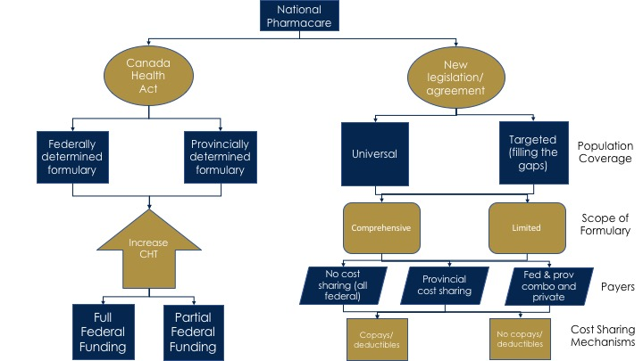
Narrowing of Options

Slide 16
Strategic Considerations
Case for national pharmacare is strong
It will be a major issue in 2019 federal election
  Do not want pharmacare to be associated with the politics of failure
  COF can play critical role in shaping the discussion
Different program pathways going forward
  Discussion paper by Federal Ministers of Finance and Health signals avoidance of amending Canada Health Act
  Separate legislation and transfer would be a major step forward
  If universal, a comprehensive formulary is better but second best option is to move forward on a limited formulary and expand over time
Notes:
Perfect should not be enemy of progress

Slide 17
Thank You!
Merci!
Kevin Page
President & CEO
Institute of Fiscal Studies and Democracy at the University of Ottawa
© Copyright 2018 IFSD Institute of Fiscal Studies and Democracy. All Rights Reserved.

